Slide 1
INDIAN ECONOMY:
A LAND OF OPPORTUNITIES
March 2024

Slide 2
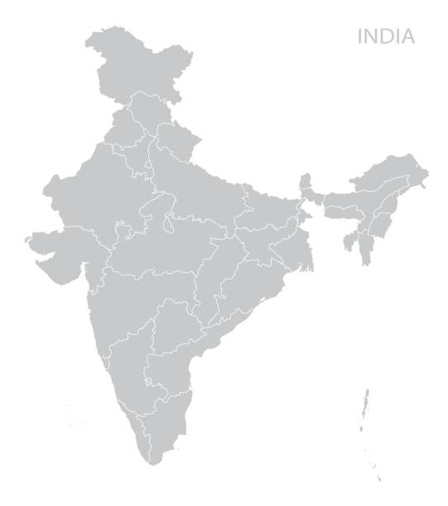
INDIA AND THE WORLD
India and the World
Indian State’s Population vis-à-vis Countries
Rwanda
INDIA
7th largest by area
Largest by population
Switzerland
Venezuela
Taiwan
United Kingdom
Brazil
World
Germany
Lithuania
South Africa
Vietnam
2022: 3.6%
Australia
Mexico
Spain
80 bps
France
Colombia
Turkey
Canada

Slide 3
INDIA: A LARGE DEVELOPING ECONOMY
India surpasses UK to become the 5th largest economy in nominal US$ terms.
India GDP in per capita terms was at US$2392 in 2022.
In terms of GDP by purchasing power parity (PPP), India ranks 3rd in the world with US$11.9 trillion as per IMF data for 2022, after China and US.
Source: IMF WEO October 2023 Database

Slide 4
INDIA’S GDP EXPECTED TO DOUBLE BY FY28
Note: From 2023-24 onwards are CII estimates
Source: IMF World Economic Outlook, CII Research
Notes:
India’s GDP took over a decade to double from US$1.7 trillion in 2010-11 to US$3.4 trillion in 2022-23.
Further, CII expects India’s GDP to double from its current rate in next five years by 2027-28.

Slide 5
INDIA’S PER CAPITA GDP TRAJECTORY TO CLASSIFY AS A HIGH-INCOME COUNTRY
As per the World Bank classification, a country’s per capita nominal GDP must be more than US$21,664 to become a high-income country by 2047.
To become a high-income country by 2047-48, India’s per capita nominal GDP would have to record a CAGR of 9.2 per cent during
2022-23 to 2047-48.
CAGR 9.2%
Source: World Bank, RBI, CII Research

Slide 6
GLOBAL GROWTH IS SLOWING DOWN
Country/Region | 2023 | 2024 | 2025
 |  | (Forecast) | (Forecast)
Advanced Economies | 1.6 | 1.5 | 1.8
United States | 2.5 | 2.1 | 1.7
Euro Area | 0.5 | 0.9 | 1.7
Japan | 1.9 | 0.9 | 0.8
Emerging and Developing Economies | 4.1 | 4.1 | 4.2
Brazil | 3.1 | 1.7 | 1.9
China | 5.2 | 4.6 | 4.1
India | 6.7 | 6.5 | 6.5
World | 3.1 | 3.1 | 3.2
Source: IMF World Economic Outlook, January 2024

Slide 7
INDIA GDP GROWTH ROBUST IN 2023-24
Indian economy is likely to grow 7.6 per cent in 2023-24, led by healthy investments and a robust manufacturing sector.
India stands as a relative bright spot in the world economy today, growing at rates significantly above its peers, despite the global flux.
Note: 2023-24 are second advance estimates
Source: CSO

Slide 8
HOWEVER, A FEW CHALLENGES REMAIN

Slide 9
INFLATIONARY PRESSURES REMAIN A CONCERN
Domestic inflation print stood at 5.09 per cent in February 2024 against 5.10 per cent in the previous month, with prices of food items remaining elevated.
India’s Central Bank, Reserve Bank of India (RBI), has raised repo rates to 6.5 per cent so far, however maintaining a pause in its last six meetings to let lagged impact of the rate hikes work through the system
RBI restated inflation target of 4%
Source: MOSPI, RBI, CII Research

Slide 10
GLOBAL SLOWDOWN IS HEADWIND FOR INDIA’S EXPORTS
Weighed down by the effects of war in Ukraine, high inflation, tighter monetary policy and financial market uncertainty, world merchandise trade growth is expected to slow to 0.8 per cent in 2023. It is however, expected to pick up to 3.3 per cent in 2024.
India’s exports stood at US$353.92 billion in Apr-Jan FY24 as compared to US$372 billion in same period last year, contracting by 4.9 per cent due to a demand slowdown witnessed in India’s major trading partners.
Source: WTO
Source: Ministry of Commerce & Industry

Slide 11
FDI FLOWS HAVE MODERATED; THOUGH INDIA IS ONE OF THE MOST PREFERRED DESTINATION
Gross FDI in India stood at US$71.4 billion in 2022-23. The cumulative gross FDI flows between Apr-Dec FY24 declined by 7.2 per cent as compared to corresponding period last year.
India is the 8th most preferred global destination for FDI flows in 2022, as per the latest UNCTAD Global Investment Report 2023 and became the third-largest host country for greenfield project announcements and the second largest for international project finance deals.
Source: RBI
Source: UNCTAD Global Investment Report 2023

Slide 12
DOING BUSINESS IN INDIA

Slide 13
SHARP IMPROVEMENT IN INDIA’S RANKING AS PER THE DOING BUSINESS REPORT BY THE WORLD BANK
As per World Bank’s global ranking of 190 economies on Business and Regulatory Environment, India’s ranking improved sharply from 142nd position in 2015 to 63rd position in 2020.
Resolving Insolvency, Dealing with Construction Permits and Trading across Borders have witnessed significant improvement in 2020.
There’s till a long way to go in areas such as Enforcing Contracts, Registering Property, Starting a Business, and Paying Taxes, where we have still not joined the league of top 100.
Source: World Bank

Slide 14
INDIA RANKS 40TH IN TERMS OF WORLD COMPETITIVENESS RANKINGS BY IMD
India ranks 40th in 2023 in World Competitiveness Rankings, having improved from 44th position in 2015.
World Competitiveness Rankings – Recent trend in India’s performance
World Competitiveness Rankings 2023: India’s Indicator Wise Performance Vis-à-Vis Other Countries (out of 64 countries)
Indicator (Overall Rank) | Denmark (1st) | Switzerland (3rd) | Singapore (4th) | USA (9th) | China (21st) | UK (29th) | New Zealand (31st) | India (40th)
Government Efficiency | 5 | 1 | 7 | 25 | 35 | 28 | 21 | 44
Business Efficiency | 1 | 7 | 8 | 14 | 21 | 34 | 35 | 28
Infrastructure | 2 | 1 | 9 | 6 | 21 | 22 | 28 | 52
Note: figures in parentheses denote world rankings
Source: IMD Business School

Slide 15
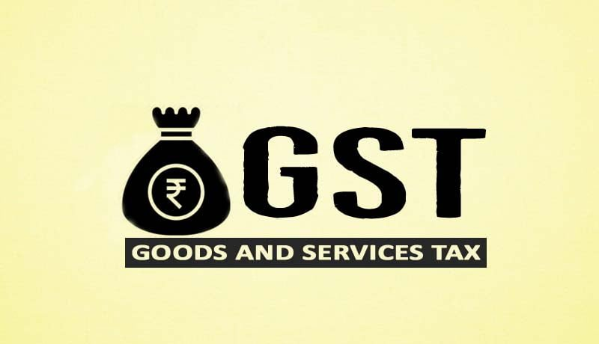
INDIA HAS AN ENABLING POLICY ENVIRONMENT WITH A STRONG FOCUS ON REFORMS

Slide 16
INDIA’S MASSIVE PUSH FOR INFRASTRUCTURE
India’s infrastructure spending as a % of GDP is one of the highest in the world. The Government of India through the National Infrastructure Pipeline is initiating projects worth $1.8 trillion in the infrastructure sector between 2019-2024. This will boost connectivity, competitiveness and build world class infrastructure in India.
Source: G20 Infrastructure Outlook

Slide 17
INDIA’S DEMOGRAPHIC DIVIDEND PRESENTS OPPORTUNITIES
Incremental addition to working age population between 2020-2050 (Mn)
India’s working-age population, its so-called Demographic Dividend, if productively employed, will help it to leapfrog its GDP from the current US$3 trillion to US$40 trillion by 2046-47.
India’s now is the most populous country in the world with 1.4 billion people, but with an average age of 29 years, it has one of the youngest populations globally.

Slide 18
RISING PACE OF POPULATION & URBANIZATION AND BURGEONING MIDDLE CLASS
Trend in India’s population & urbanisation
Number of Households (in Million)
293 million
386 million
High 8
(3%)
High 29 (7%)
Upper Middle
61 (21%)
Upper Middle
168 (44%)
Lower Middle
97 (33%)
Lower Middle
132 (34%)
Low
127 (43%)
Low
57 (15%)
2018
2030 forecast
Source: CRIS estimates, McKinsey Global Institute
Source: WEF's Future of Consumption in Fast-Growth Consumer Markets: India 2019 report
Note: Household income per annum in 2017-18 prices by income segment. Poverty line at <$2 (< INR 125) per day per person. Projections with annual GDP growth assumed at 7.5 per cent.

Slide 19
KEY GROWTH SECTORS

Slide 20
To sum up……
PROMINENT MANUFACTURING SECTORS
Automotive
Chemicals
Electronics
FMCG
Metals & Mining
Pharmaceutical
Textiles
Capital Goods
Although all sector present attractive investment and trade opportunities, we focus on a few resurging or emerging high-potential sectors

Slide 21
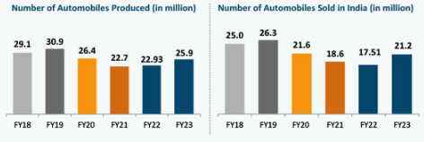
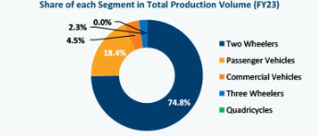
AUTOMOTIVE
The Automotive sector in India plays a key role in both macroeconomic expansion and technological advancement of the economy.
The two-wheeler segment dominates the market in terms of volume, owing to a growing middle class and huge percentage of India’s population being young.
The sector received cumulative equity FDI inflow of about US$34.1 billion between April 2000-December 2022. The government expects the sector to attract $8-10 billion investments in 2023.
India could be a leader in shared mobility by 2030, providing opportunities for electric and autonomous vehicles. The government has committed that 30% of new vehicle sales in India by 2030 will be electric.
Key market players

Slide 22
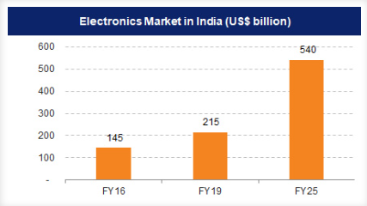
ELECTRONICS
The Indian Electronics System Design and Manufacturing (ESDM) sector is one of the fastest growing sectors in the economy and is witnessing a strong expansion in the country.
Key sector highlights -
The largest consumer electronics markets in Asia Pacific Region.
Has committed to reach US$ 300 billion worth of electronics manufacturing and exports of US$ 120 billion by 2025-26.
Electronics manufacturing industry is projected to reach US$520 billion by 2025.
Top products under ESDM sector include IT, industrial electronics, automotive electronics
Key government initiatives for the sector

Slide 23
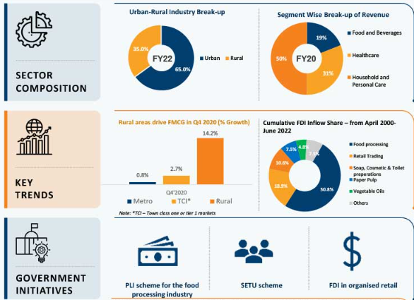
FAST-MOVING CONSUMER GOODS (FMCG)
FMCG is India’s fourth largest sector and has been expanding at a healthy rate over the years due to rising disposable income, rising youth population as well as rising brand awareness among consumers. With household and personal care accounting for ~50 per cent of FMCG sales in India, the industry is an important contributor to India’s GDP.
Source: IBEF

Slide 24
TEXTILES
India is the world’s second-largest producer of textiles and garments. It is the fifth-largest exporter of textiles spanning apparel, home and technical products. It also enjoys a comparative advantage in terms of skilled manpower and in cost of production relative to other major textile products.
India has a 4.0 per cent share of global trade in textile and apparels.
Key sector highlights -
Contributes 2.3% to India’s GDP
Employs over 45 million people
Contributes 12% to India’s exports
Contributes 13% to India’s industrial production
Key government initiatives for the sector

Slide 25
PROMINENT SERVICES SECTORS
IT & ITeS
Healthcare
Tourism
Transport & Logistics
FinTech
Real Estate
Media & Entertainment
Education
Telecom
India is a leading player across numerous service sectors. This presentation focuses on opportunities in the highlighted sectors.

Slide 26
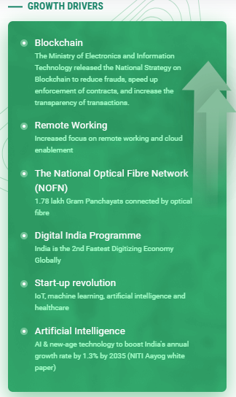
IT & ITeS
IT sector has become one of the most significant growth catalysts for the Indian economy, contributing significantly to the country’s GDP. The IT industry accounted for 7.4 per cent of India’s GDP in FY22 and is expected to contribute 10 per cent to India’s GDP by 2025.
India has one of the largest interest user bases and cheapest interest rates in the world.
India has the quickest pace of digital adoption in the world.
Key market players

Slide 27
FINTECH INDUSTRY
India is amongst the fastest growing Fintech markets in the world, driven by an increasing smartphone penetration, government’s push towards a cashless economy and favorable regulatory policies.
India Stack
Open API platforms such as Aadhar, UPI, GSTN
Increasing internet and smartphone penetration
India already has the 2nd highest number of smartphone users globally and is also the 2nd largest internet user market
Aadhar: world’s largest biometric identification system – 1.3 billion Aadhar generated so far
UPI transaction volume increased to 51.9 billion in first half 2023
Favorable demographics
68 per cent of India’s population is young and is driving the demand and growth of Indian fintech space
Financial inclusion initiatives
Financial inclusion program such as PMJDY, Direct Benefit Transfer, Atal Pension Yojana, among others have accelerated the digital revolution and brought more citizens, especially in rural areas within the ambit of digital financial services
Source: Invest India

Slide 28
REAL ESTATE
In India, the real estate sector is the second-highest employment generator, after the agriculture sector. Its ranking in the Global Real Estate Transparency Index improved to 34 in 2022 from 39 in 2014, on the back of regulatory reforms, better market data and green initiates.
The Real Estate sector is expected to reach US$650 billion by 2025 and US$1 trillion by 2030, up from US$200 billion in 2021 and contribute ~13 per cent to the country’s GDP by 2025.
Demand for commercial space and residential space on a rise in the country, largely led by rapid urbanization
Source: IBEF, Cushman & Wakefield, Knight Frank Research

Slide 29
HEALTHCARE
The Indian healthcare sector recorded a three-fold rise, growing at a CAGR of 22 per cent between 2016-22 to reach US$372 billion in 2022 from US$110 billion in 2016.
Government initiatives under Healthcare sector
Source: IBEF

Slide 30
INDIA’S TRADE WITH LITHUANIA

Slide 31
INDIA’S EXPORTS TO LITHUANIA HAVE SEEN A STEADY RISE OVER THE YEARS p……
The bilateral trade between India and Lithuania moderated to US$471.6 million in 2022-23 from a record of US$531.8 million in 2021-22. Major Indian exports to Lithuania include nuclear boilers & reactors, pharmaceuticals, organic chemicals, textile articles, among others.
Source: Ministry of Commerce & Industry

Slide 32
THANK YOU

