Slide 1
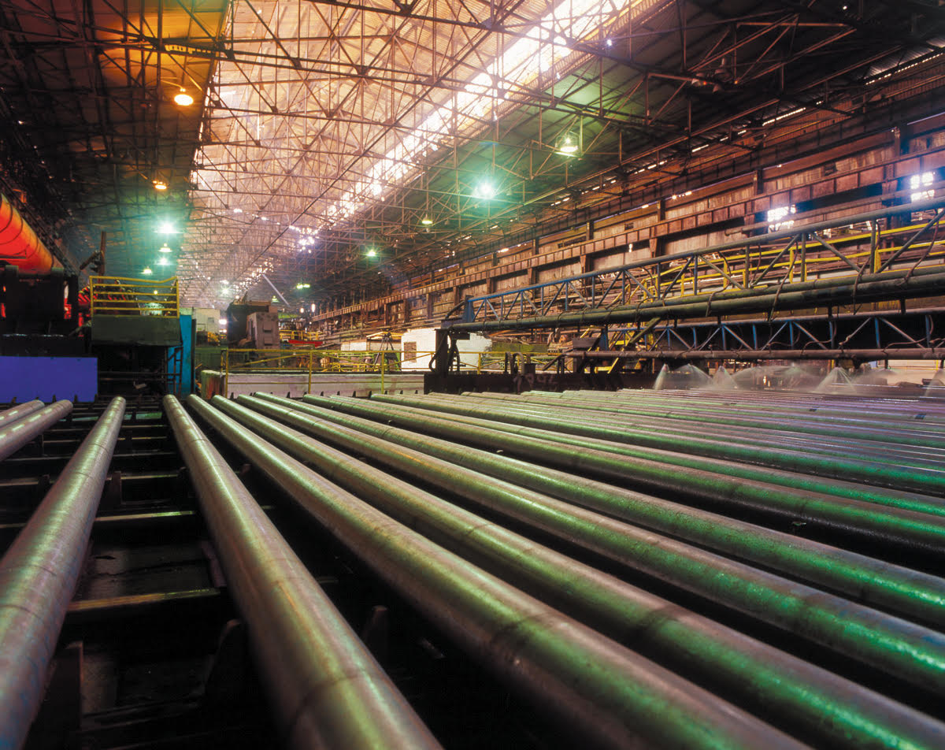
Dnepropetrovsk Tube Works

Slide 2
MARKET POSITION
PJSC “Dnepropetrovsk Tube Works” takes first place in Ukraine in the production of cold-deformed and second place in the production of hot-deformed seamless pipe.

Slide 3
OPPORTUNITIES
The combination of unique production equipment (pipe rolling unit - 80), equipment for pipe threading) with a favorable situation on the domestic market (conducting an anti-dumping investigation in respect of seamless pipe from PRC and pipe import prohibition from the Russian Federation) provide the following options:
after the modernization of production facilities, ensure the production of high-margin products of a high degree of processing, not sensitive to demand fluctuations, in the amount of 150 thousand tons per year;
entering new markets, including markets for building constructions, with a new product - a profile seamless pipe;
ensuring the dominant position of Plant in the tender procurement of the highest margin pipes consumed by natural monopolists of the oil and gas industries.

Slide 4
The production volume in 2013 - 6 months of 2019, tons

Slide 5
The volume of domestic pipe consumption in Ukraine in 2018. Domestic production, thousand tons.

Slide 6
The volume of domestic pipe consumption in Ukraine in 2018. Import, thousand tons

Slide 7
BRIEF INFORMATION.
The Dnepropetrovsk Tube Works is equipped with modern mechanized and automated pipe-rolling units capable of producing high-quality products in the amount of up to 240,000 tons of pipes of various grades per year.
The company has the ability to produce more than 3,000 profile sizes of seamless pipes from carbon and low alloy steels for various purposes - water, gas, oil, boiler, profile, precision, marine, bimetal for plain bearings, general purpose pipes.
SORTMENT:
Hot-deformed seamless steel pipes with a diameter from 57.0 to 89.0 mm (when starting pipe rolling unit 140 - up to 168 mm) with a wall thickness of 2.9 to 12.0 mm;
Cold-deformed seamless steel pipes with a diameter from 10.0 to 73.0 mm with a wall thickness of 1.0 to 12.0 mm.

Slide 8
BRIEF INFORMATION. CERTIFICATION.
Dnepropetrovsk Tube Works is one of the leading enterprises in the Ukrainian pipe industry. The quality of products is confirmed by the following documents::
1. Certificate for quality management system, according to requirements of ISO 9001: 2015, IDT.
2. Certificate of Conformity "Seamless hot-deformed steel pipes for steam boilers and pipelines from steel grade 20 PV".
3. Certificate of Conformity "Seamless cold-deformed steel pipes for steam boilers and pipelines from steel grade 20 PV".
4. Certificate of conformity “Seamless steel pipes for boiler plants and pipelines”.
5. Certificate of conformity "Seamless steel pipes hot and cold deformed”.

Slide 9
BRIEF INFORMATION. CERTIFICATION.
6. Certificate of conformity "Seamless steel pipes hot-deformed for gas pipelines of gas-lift systems and arrangement of gas fields”.
7. Certificate of conformity for Pressure Equipment for Specifications EN 10216-1, EN 10216-2, EN 10216-3, EN 10216-4, DIN EN 10216-1, DIN EN 10216-2, DIN EN 10216-3, DIN EN 10216-4, DIN EN ISO 3183.
8. Certificate for quality management system, as required "Seamless tubes from ferrite steels" according to Directive 2014/68/EU and standards DIN EN 754-5, DIN EN 764-5 and requirements analogous to code AD 2000-W0.
9. Certificate of conformity of the Factory Production control to standard DIN EN 10219-1:2006 and DIN EN 10210-1:2006 from structural steels with strength level S235 up to S355.
The company's products are supplied to the USA, Germany, Italy, Poland, Israel, Turkey, Greece, Bulgaria, Lebanon, Egypt, Tunisia, the United Arab Emirates, Saudi Arabia, and Spain.

Slide 10
BRIEF INFORMATION. BASIC WORKSHOPS.
The Dnepropetrovsk Tube Works consists of four main production workshops:
Seamless pipe workshop
Pipe rolling workshop -2
Pipe rolling workshop -3
Electric welding workshop (mothballed)

Slide 11
BRIEF INFORMATION. INFRASTRUCTURE.
The Dnepropetrovsk Tube Works has an appropriate production and technical infrastructure that ensures the functioning of the main workshops.
The company has certified laboratories for carrying out technological tests and product quality control, diagnostics and equipment condition monitoring, ensuring a reverse cycle and protecting the environment.
An automated system for managing production, sales, finances, equipment loading, accounting and analysis of the delivery, shipment and sale of finished products, which is integrated with the accounting, reporting and staff management system, has been implemented.

Slide 12
BRIEF INFORMATION. EQUIPMENT.
Seamless pipe workshop:
pipe rolling unit 80 with continuous 8 cage and reduction-extension 30 cage mills;
pipe rolling unit 140 with longitudinal rolling mills and a gauge 12 stand mill (mothballed).
Pipe rolling workshop-2:
6 cold rolling mills;
3 three-thread drawing mills.

Slide 13
BRIEF INFORMATION. EQUIPMENT.
Pipe rolling workshop-3:
9 cold rolling mills;
9 drawing mills;
1 pipe profile mill.
Electric welding workshop:
electric pipe welding mill 57-159 (mill No. 1);
electric pipe welding mill 57-159 (mill No. 2).

Slide 14
SALES MARKETS. UKRAINE.
Decreasing of pipe consumption by regular consumers is noted, which is due to both objective economic and political factors, and problems with ensuring a rhythmic supplying of pipe from Dnepropetrovsk Tube Works. Problems in financing of energy and gas industries. Decreasing of production volumes in Mechanical Engineering and carriage building.
The sales volume is up to 1,500 tons per month (excluding participation in large tenders of Ukrgasvydobuvannya, as well as covering the needs of Metinvest and DTEK).
At the same time, the Ukrainian market is one of the priorities, taking into account anti-dumping investigations against pipe products from PRC and the ban on import of pipe from the Russian Federation, after reconstruction, its capacity for Dnepropetrovsk Tube Works products is estimated at 3,400 tons per month.

Slide 15
SALES MARKETS. EU.
The EU market remains one of the key foreign markets for Dnepropetrovsk Tube Works due to its capacity and high demand for water and gas pipelines pipes, which are a priority for the enterprise. The current supply volume is up to 1,500 tons per month.
Provided that production and delivery terms are guaranteed, reconstruction is carried out, the assortment of the delivered pipe is expanded and mechanical requirements are met, shipping to the region may increase to a total volume of 2,800 tons per month.

Slide 16
SALES MARKETS. USA.
Currently, sales are limited to 500 tons per month. Since 2006 to 2009 sales reached 20,000 tons per year. Against the background of an improvement in the general economic climate in the USA, there is an increase in demand for metal products from Mechanical Engineering, the automotive industry and construction.
After the reconstruction, including obtaining API 5L and 5CT certificates, expanding the range of products, providing satisfactory conclusions on quality, guaranteeing fulfillment of obligations on the delivery dates of pilot batches, as well as launching an automated packaging and painting line, the prospective sales of Dnepropetrovsk Tube Works products in the USA are estimated at 2,300 tons per month.

Slide 17
SALES MARKETS. MIDDLE EASTERN REGION.
The sales volume is up to 750 tons per month. Sales to the Middle East and North Africa market are complicated by the extreme instability of the political situation in Egypt, which is the center of large and small-scale metal trading throughout the North African region.
There is fierce competition from Turkey and PRC. Given the low level of market prices in this region, increasing marginal income is problematic. The possibilities of delivering pipe products to the market are also limited due to the lack of certification according to API 5L. After the reconstruction and obtaining API 5L and 5CT certificates, as well as the launch of an automated packaging and painting line, the region's consumption of Dnepropetrovsk Tube Works products is estimated at 2,100 tons per month.

Slide 18
SALES MARKETS. RUSSIAN FEDERATION.
Before the introduction of import restrictions, the Russian Federation was one of the main sales markets in the amount of up to 25,000 tons per year. After the introduction of an anti-dumping duty of 37.8% (for hot-deformed pipes), Dnepropetrovsk Tube Works lost this large market, with the possibility of supplying only cold-deformed pipes in an amount of up to 6,000 tons per year.
After the introduction of restrictive measures in the form of a complete ban on imports of pipe from Ukraine, the restoration of this market in the foreseeable future seems problematic.

Slide 19
SALES MARKETS. CIS COUNTRIES.
Current sales - up to 750 tons per month. The main consumer of Dnepropetrovsk Tube Works products is Republic of Belarus and Azerbaijan. Active sales to other CIS countries are limited by the ability to conduct settlements and provide acceptable conditions for deferred payment.
Mechanical Engineering is actively developing in the Republic of Belarus, in connection with which an increase in demand for seamless pipes is expected. In Azerbaijan, Socar is the largest consumer of Dnepropetrovsk Tube Works products.
Subject to the reconstruction and expansion of the range of products, subject to the guarantee of fulfillment of obligations on delivery dates, the expected volume of sales of pipe products to the region will be 1,900 tons per month.

Slide 20
SALES MARKETS. FORECAST.
Destination country | Sale of pipes
 | Current, tons per month | Planned, tons per month
Ukraine | 1500 | 3400
EU | 1500 | 2800
USA | 500 | 2300
Middle Eastern Region | 750 | 2100
Russian Federation | 0 | 0
CIS countries | 750 | 1900
TOTAL | 5000 | 12500

Slide 21
PRODUCTION CAPACITY.
The increase in production capacity is expected to be achieved through the implementation of the following action plan, which can conditionally be divided into the following stages:
Stage I (production of 60 thousand tons per year):
carrying out of equipment maintenance;
renewal of ISO certificates of conformity;
modernization of non-destructive testing equipment;
modernization of levelling machines;
installation of rust remove equipment;
installation of an automatic pipe painting line (demanded by the markets of the USA, Egypt and the Middle East).

Slide 22
PRODUCTION CAPACITY.
Stage II (production of 150 thousand tons per year):
repairing of the first section of pipe rolling unit 80;
repairing of pipe rolling unit 140;
launch of Pipe rolling workshop-2;
certification in accordance to API 5L and 5CT;
start of pipe producing in accordance to GOST 633, API 5L and 5 CT;
start of mechanical thick-walled pipe producing (up to 16 mm) on pipe rolling unit 80.

Slide 23
SALES MARKETS. LOGISTICS.
Destination country | Transport | Terms of delivery
Ukraine, EU, CIS countries (except Azerbaijan and Belarus) | Automobile transport | FCA
Belarus | Automobile transport | FCA, CPT
Azerbaijan | Automobile transport Railway | CPT
USA, Middle East, North Africa, Turkey | Railway (Ports of Greater Odessa) | FOB Ports of Greater Odessa FCA sea container
 | Maritime transport | CIF
Russian Federation | Railway | EXW, FCA

Slide 24
CHANGES IN MARGINAL INCOME.
 | Annual production volume | Margin | Total
I Stage
Hot-deformed seamless pipe | 48 000 | 100 | 4 800 000,00
Cold-deformed seamless pipe | 12 000 | 300 | 3 600 000,00
TOTAL per year |  |  | 8 400 000,00
II Stage
Hot-deformed seamless pipe | 126 000 | 100 | 12 600 000,00
Cold-deformed seamless pipe | 24 000 | 300 | 7 200 000,00
TOTAL per year |  |  | 19 800 000,00

